Slide 1
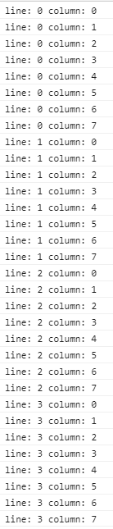
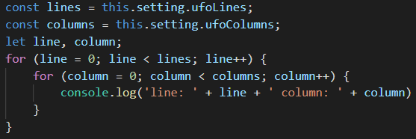
Create enemies - Nested loop of UFOS
8 columns
4 lines

